Slide 1

8th Grade Math: Pre-Algebra
Unit 9, Lesson 5 Rotations on the Coordinate Plane Volume 2, pg. 82

Slide 2


Benchmark
MA.8.GR.2.3
Describe and apply the effect of a single transformation on two-dimensional figures using coordinates and the coordinate plane.
volume 2, pg. 82

Slide 3
Integrated Mathematical Thinking and Reasoning Standards
MA.K12.MTR.1.1 Actively participate in effortful learning both individually and collectively.
MA.K12.MTR.2.1 Demonstrate understanding by representing problems in multiple ways.
MA.K12.MTR.4.1 Engage in discussions that reflect on the mathematical thinking of self and others.
volume 2, pg. 82

Slide 4

Learning Targets
I can perform a rotation on the coordinate plane.
I can describe relationships between figures after a rotation.
volume 2, pg. 82

Slide 5

Warm-Up
volume 2, pg. 82

Slide 6
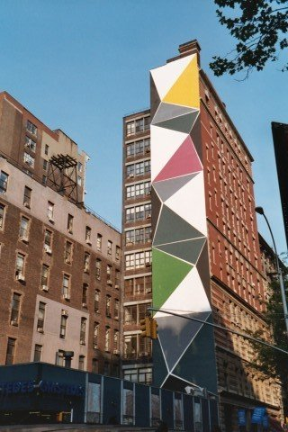
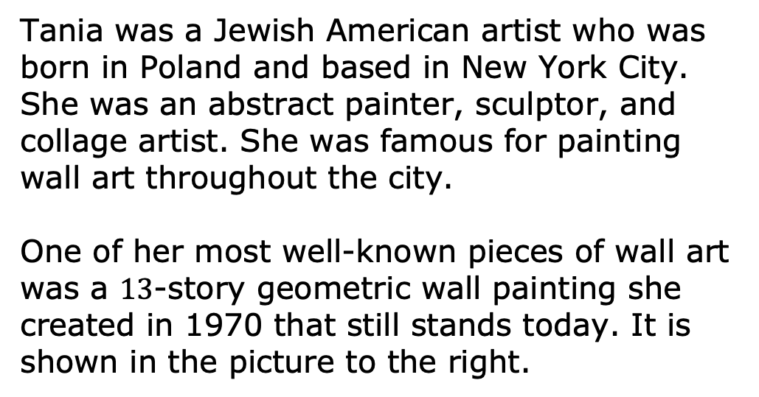
9.5.1 Warm-Up: Geometry in Art
Tania was a Jewish American artist who was born in Poland and based in New York City. She was an abstract painter, sculptor, and collage artist. She was famous for painting wall art throughout the city.
One of her most well-known pieces of wall art was a $13$-story geometric wall painting she created in 1970 that still stands today. It is shown in the picture to the right.
volume 2, pg. 82

Slide 7
Consider the yellow and green triangles shown in the artwork.
Explain whether you think a single transformation could map the yellow triangle to the green triangle.
Which two transformations do you think could map the yellow triangle to the green triangle if one was performed followed by the other?
volume 2, pg. 82

Slide 8

Exploration
volume 2, pg. 83

Slide 9

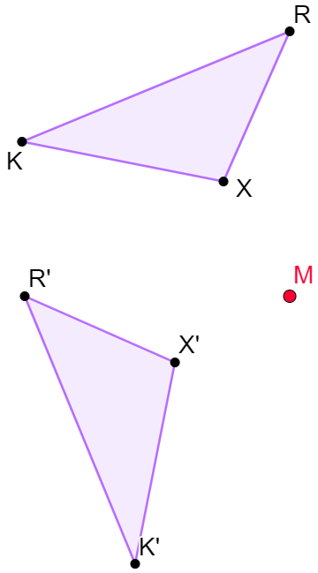
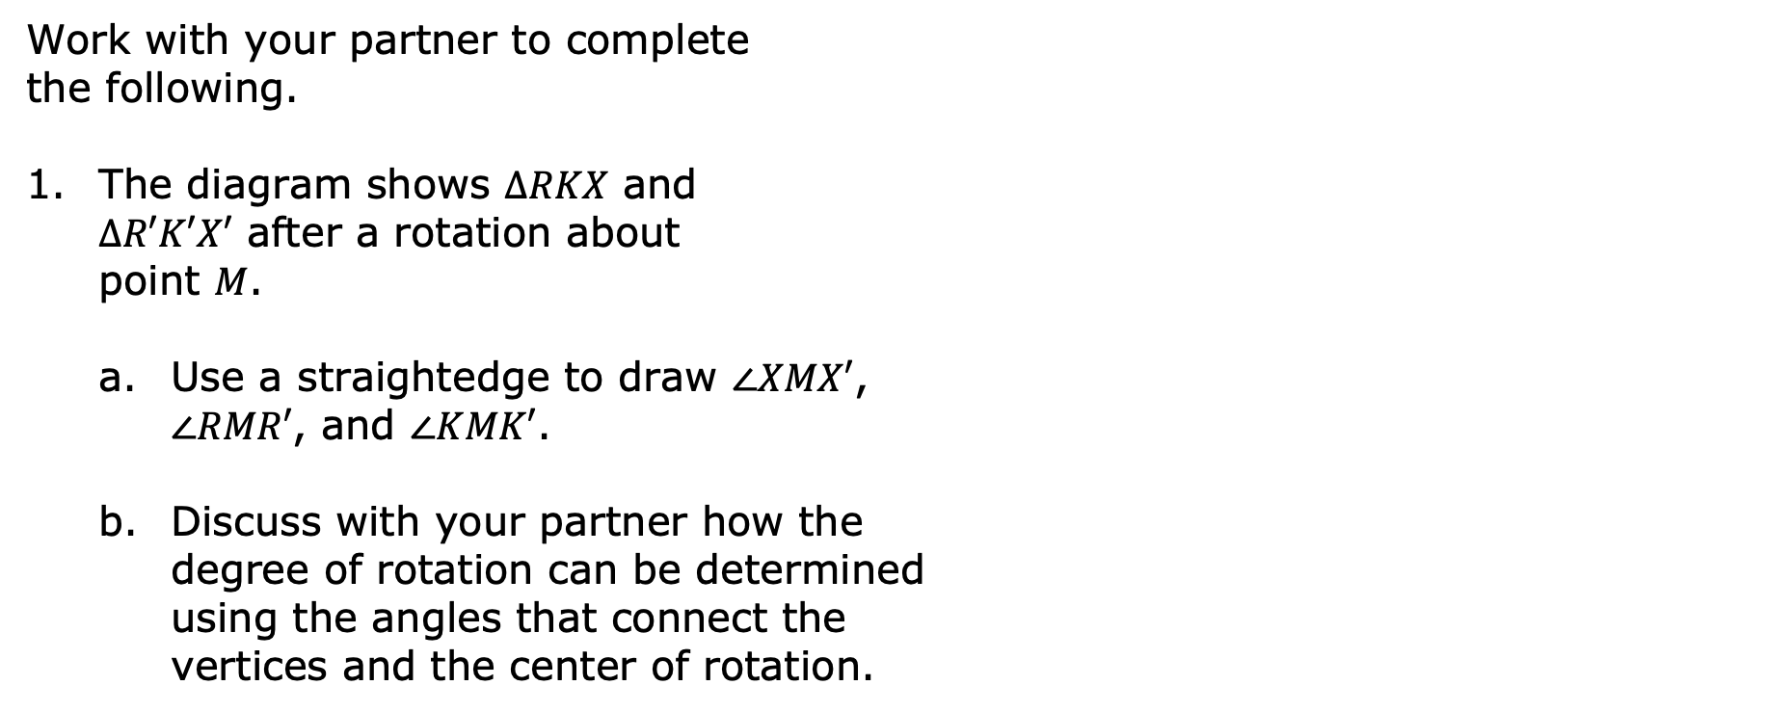
9.5.2 Exploration: Determining the Degree of Rotation
Work with your partner to complete the following.
The diagram shows $∆RKX$ and $∆R′K′X′$ after a rotation about point $M$.
Use a straightedge to draw $∠XMX′$, $∠RMR′$, and $∠KMK′$.
Discuss with your partner how the degree of rotation can be determined using the angles that connect the vertices and the center of rotation.
volume 2, pg. 83

Slide 10
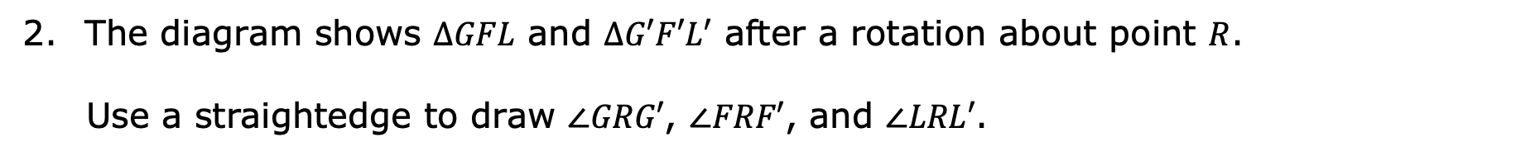
The diagram shows $∆GFL$ and $∆G′F′L′$ after a rotation about point $R$.
Use a straightedge to draw $∠GRG′$, $∠FRF′$, and $∠LRL′$.
volume 2, pg. 83

Slide 11
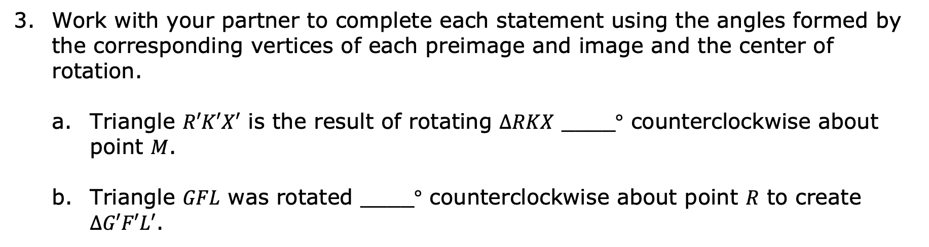
Work with your partner to complete each statement using the angles formed by the corresponding vertices of each preimage and image and the center of rotation.
Triangle $R′K′X′$ is the result of rotating $∆RKX$ ____$°$ counterclockwise about point $M$.
Triangle $GFL$ was rotated ____$°$ counterclockwise about point $R$ to create $∆G′F′L′$.
volume 2, pg. 83

Slide 12

Guided Instruction
volume 2, pg. 84

Slide 13
9.5.3 Guided Instruction: Rotations on the Coordinate Plane
On the coordinate grid below, $∆STU$ is rotated to create $∆S′T′U′$.
volume 2, pg. 84

Slide 14
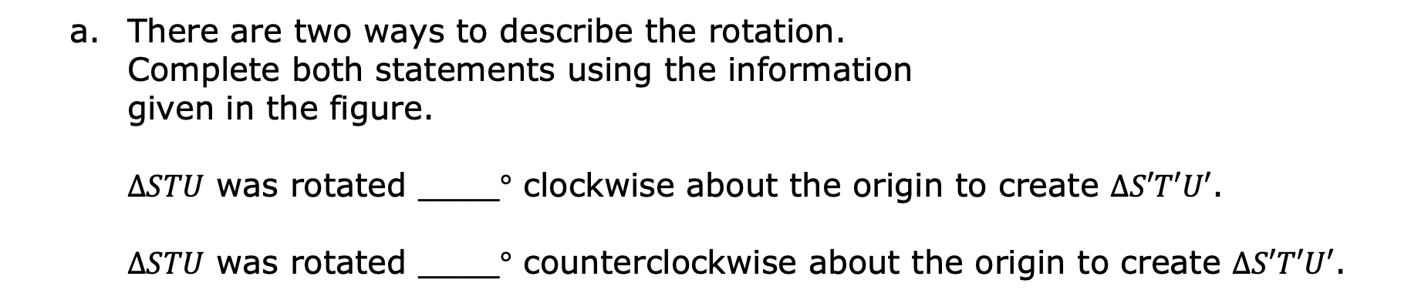
There are two ways to describe the rotation. Complete both statements using the information given in the figure.
$∆STU$ was rotated ____$°$ clockwise about the origin to create $∆S′T′U′$.
$∆STU$ was rotated ____$°$ counterclockwise about the origin to create $∆S′T′U′$.
volume 2, pg. 84

Slide 15
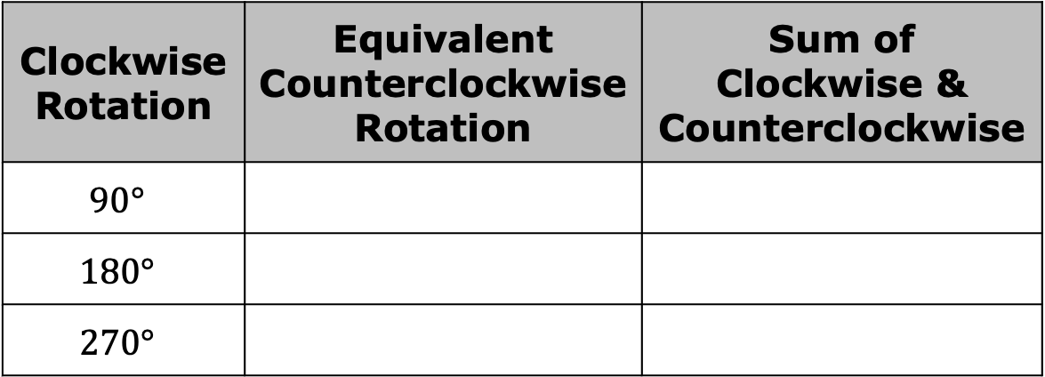

For every rotation clockwise, there is a rotation counterclockwise that would create the same image. Complete the table.
Explain what would happen if a figure were rotated $360°$ with the origin as the center of rotation.
Clockwise Rotation | Equivalent Counterclockwise Rotation | Sum of Clockwise & Counterclockwise
$$90°$$
$$180°$$
$$270°$$
volume 2, pg. 84

Slide 16
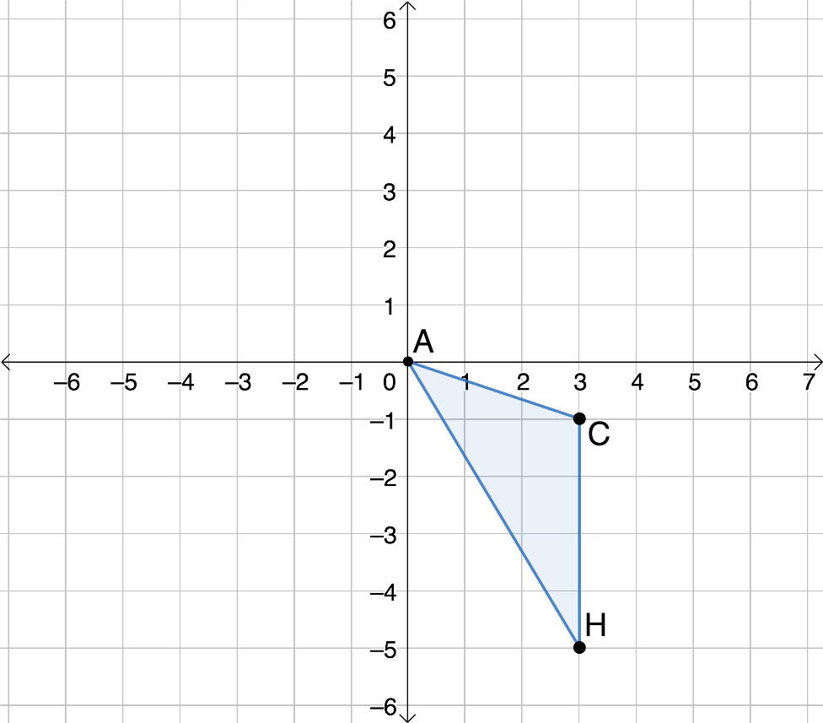
Triangle $ACH$ is shown on the coordinate grid.
volume 2, pg. 84

Slide 17
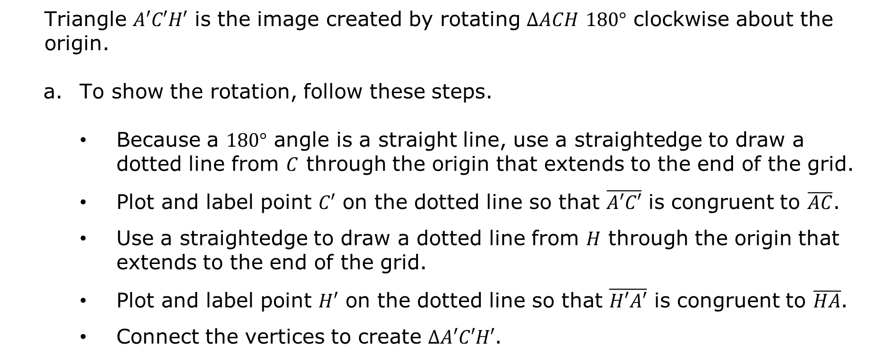
Triangle $A′C′H′$ is the image created by rotating $∆ACH$ $180°$ clockwise about the origin.
To show the rotation, follow these steps.
Because a $180°$ angle is a straight line, use a straightedge to draw a dotted line from $C$ through the origin that extends to the end of the grid.
Plot and label point $C′$ on the dotted line so that $\overline{A′C′}$ is congruent to $\overline{AC}$.
Use a straightedge to draw a dotted line from $H$ through the origin that extends to the end of the grid.
Plot and label point $H′$ on the dotted line so that $\overline{H′A′}$ is congruent to $\overline{HA}$.
Connect the vertices to create $∆A′C′H′$.
volume 2, pg. 85

Slide 18
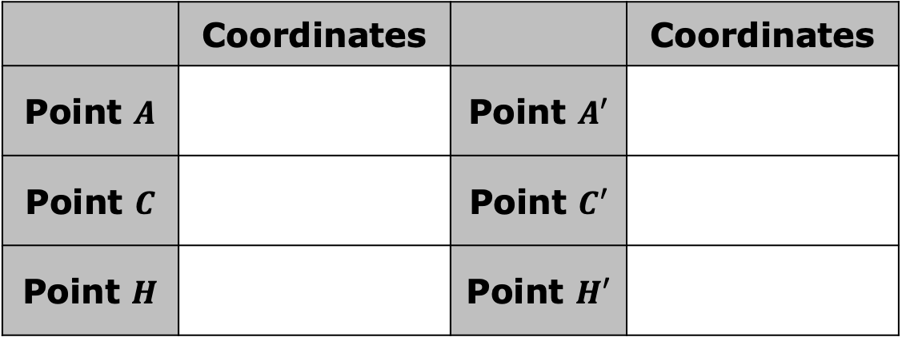

Describe how point $A$ and point $A′$ relate to each other.
Complete the table with the coordinates of each point.
What do you notice about the coordinates of the corresponding points in the preimage and the image after this rotation?
 | Coordinates |  | Coordinates
Point $A$ |  | Point $A′$
Point $C$ |  | Point $C′$
Point $H$ |  | Point $H′$
volume 2, pg. 85

Slide 19

Collaboration
volume 2, pg. 85

Slide 20

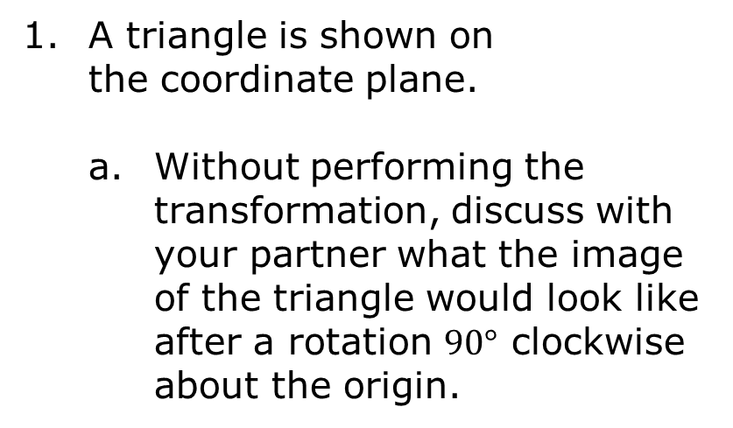
9.5.4 Collaboration: Which Quadrant?
A triangle is shown on the coordinate plane.
Without performing the transformation, discuss with your partner what the image of the triangle would look like after a rotation $90°$ clockwise about the origin.
volume 2, pg. 85

Slide 21
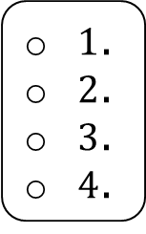
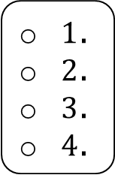
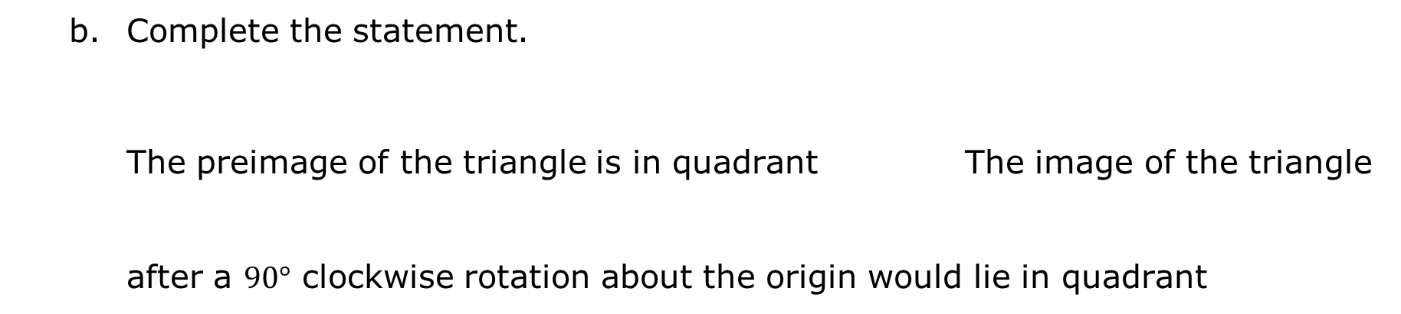
Complete the statement.
The preimage of the triangle is in quadrant The image of the triangle after a $90°$ clockwise rotation about the origin would lie in quadrant
$1$.
$2$.
$3$.
$4$.
$1$.
$2$.
$3$.
$4$.
volume 2, pg. 85

Slide 22
A quadrilateral is shown on the coordinate plane.
volume 2, pg. 86

Slide 23
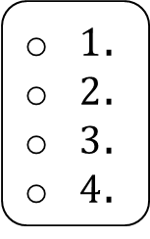
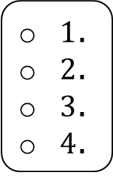
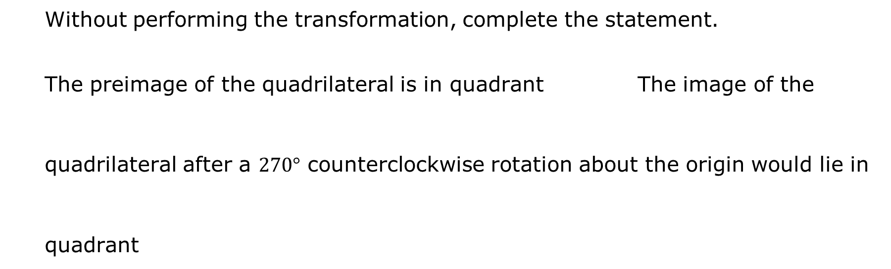
Without performing the transformation, complete the statement.
The preimage of the quadrilateral is in quadrant The image of the quadrilateral after a $270°$ counterclockwise rotation about the origin would lie in quadrant
$1$.
$2$.
$3$.
$4$.
$1$.
$2$.
$3$.
$4$.
volume 2, pg. 86

Slide 24

Guided Practice
volume 2, pg. 86

Slide 25

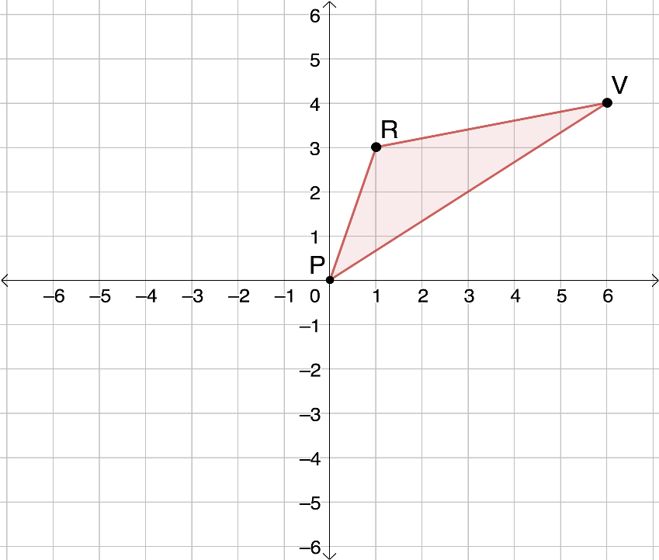
9.5.5 Guided Practice: Rotations on the Coordinate Plane
Triangle $PRV$ is plotted on the coordinate grid.
volume 2, pg. 86

Slide 26
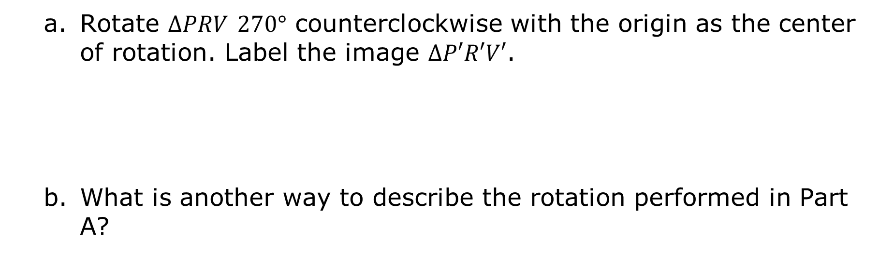
Rotate $∆PRV$ $270°$ counterclockwise with the origin as the center of rotation. Label the image $∆P′R′V′$.
What is another way to describe the rotation performed in Part A?
volume 2, pg. 86

Slide 27

Wrap-Up
volume 2, pg. 87

Slide 28

9.5.6 Wrap-Up: Reflection
Take a SELFIE by checking the box that best matches what you did today.
Showed my work
Explained my answers
Lots of math vocabulary used
Found multiple solutions
I persevered through the problem
Eliminated careless errors
volume 2, pg. 87

